Slide 1
Unit V
TURING MACHINES
2

Slide 2
Outline
Formal definition of a Turing machine,
Recursive Languages and Enumerable Languages,
Design of Turing machines,
Variants of Turing Machines:
Multi-tape Turing machines,
Universal Turing Machine,
Nondeterministic Turing machines.
Comparisons of all
Recursively
automata

Slide 3
So far in our development of the theory of computation, we have presented several models of computing devices.
Finite automata are good models for devices that have a small amount of memory.
Pushdown automata are good models for devices that have an unlimited memory that is usable only in the last in, first out manner of a stack.
We have shown that some very simple tasks are beyond the capabilities of these models.
Hence they are too restricted to serve as models of general purpose computers.

Slide 4
Turing Machine
A conceptual model for general purpose computers proposed by Alan Turing in 1936. p
A Turing machine has an unlimited and unrestricted amount of memory.
A Turing machine can do everything a real computer can do.
Nevertheless there are problems that a Turing machine cannot solve.
In a real sense, these problems are beyond the theoretical limits of computations.

Slide 5
_{a}n_{b}n_{c}n ? ww ?
The Language Hierarchy
Context-Free Languages
_{a}n_{b}n
ww^{R}
Regular Languages
a *
a *b *

Slide 6

Languages accepted by
Turing Machines
_{a}n_{b}n_{c}n ww
Context-Free Languages
_{a}n_{b}n
ww^{R}
Regular Languages
a *
a *b *

Slide 7
The hierarchy
Class | Grammars | Languages | Automaton
Type-0 Type-1 | Unrestricted Context-sensitive | Recursively enumerable (Turing-recognizable) ^{Turing machine} Context-sensitive Linear-bounded
Type-2 | Context-free | Context-free | Pushdown
Type-3 | Regular | Regular | Finite

Slide 8
The hierarchy
Class | Grammars | Languages | Automaton
Type-0 Type-1 | Unrestricted Context-sensitive | Recursively enumerable (Turing-recognizable) ^{Turing machine} Context-sensitive Linear-bounded
Type-2 | Context-free | Context-free | Pushdown
Type-3 | Regular | Regular | Finite

Slide 9
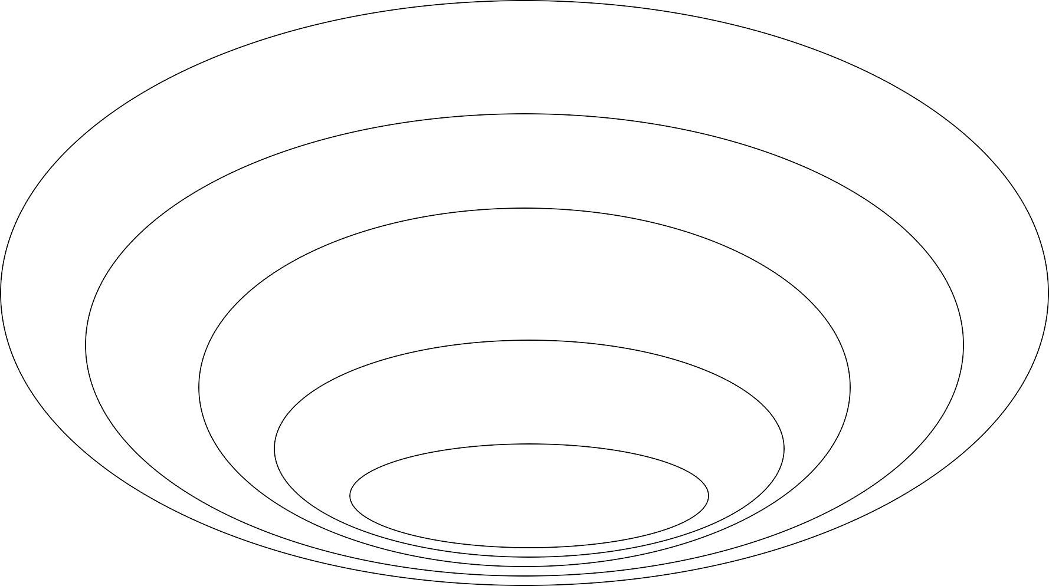
The Chomsky Hierarchy
Non Turing-Acceptable
Turing-Acceptable decidable
Context-sensitive Context-free Regular

Slide 10
Turing Machines are…
Very powerful (abstract) machines that could simulate any modern day computer (although very, very slowly!)
For every input, answer YES or NO
Why design such a machine?
If a problem cannot be “solved” even using a TM,
then it implies that the problem is unsolvable
Computability vs. Decidability
11

Slide 11
A Turing Machine
Tape
...... |  |  |  |  |  |  |  |  |  | ......
Read-Write head
Control Unit

Slide 12
The Tape
No boundaries -- infinite length
...... |  |  |  |  |  |  |  |  |  | ......
Read-Write head
The head moves Left or Right

Slide 13
Read-Write head
...... |  |  |  |  |  |  |  |  |  | ......
The head at each transition (time step):
Reads a symbol
Writes a symbol
Moves Left or Right

Slide 14
Example:
Time 0
...... |  |  | a | b | a | c |  |  |  | ......
Time 1
Reads a
Writes k
Moves Left
...... |  |  | a | b | k | c |  |  |  | ......

Slide 15
Time 1
...... |  |  | a | b | k | c |  |  |  | ......
Time 2
...... |  |  | a | f | k | c |  |  |  | ......
Reads b
Writes
f
3. Moves Right

Slide 16
The Input String
Input string
Blank symbol
...... | ◊ | ◊ | a | b | a | c | ◊ | ◊ | ◊ | ......
head
Head starts at the leftmost position of the input string

Slide 17
States & Transitions
Write
Read
Move Left
a → b, L
q₁
q₂
Move Right
Reads a
Writes b
Moves Left
a → b, R
q₁
q₂

Slide 18
Example:
Time 1
q₁
current state
...... | ◊ | ◊ | a | b | a | c | ◊ | ◊ | ◊ | ......
a → b, R
q₁
q₂

Slide 19
Time 1
q₁
Time 2
q₂
...... | ◊ | ◊ | a | b | a | c | ◊ | ◊ | ◊ | ......
...... | ◊ | ◊ | a | b | b | c | ◊ | ◊ | ◊ | ......
a → b, R
q₁
q₂

Slide 20
Example:
Time 1
q₁
Time 2
...... | ◊ | ◊ | a | b | a | c | ◊ | ◊ | ◊ | ......
...... | ◊ | ◊ | a | b | b | c | ◊ | ◊ | ◊ | ......
q₂
q₂
a → b, L
q₁

Slide 21
Example:
Time 1
q₁
Time 2
q₂
...... | ◊ | ◊ | a | b | a | c | ◊ | ◊ | ◊ | ......
...... | ◊ | ◊ | a | b | b | c | g | ◊ | ◊ | ......
→ g, R
q₁
q₂

Slide 22
Formal Definitions for
Turing Machines

Slide 23
Turing Machine:
Input alphabet
Tape alphabet
States
M = (Q, Σ, Γ, δ , q₀ , ◊, F )
Transition function
Accept states
Initial state
blank

Slide 24
A Turing Machine (TM)
This is like the CPU &
program
counter
M = (Q, ∑, Γ, δ, q₀,B,F)
Tape is the memory
Finite control
Tape head
Infinite tape with tape symbols
… | B | B | B | X₁ | X₂ | X₃ | … | X_{i} | … | X_{n} | B | B | …
 |  |  |  | Input & output tape symbols
B: blank symbol (special symbol reserved to indicate data boundary)

Slide 25
You can also use:
➔ for R
⬅ for L
Transition function
One move (denoted by |---) in a TM does the following:
δ(q,X) = (p,Y,D)
X / Y,D
q
p
q is the current state
X is the current tape symbol pointed by tape head
State changes from q to p
After the move:
X is replaced with symbol Y
If D=“L”, the tape head moves “left” by
one position.
Alternatively, if D=“R” the tape head moves “right” by one position.

Slide 26
Transition Function
a → b, R
q₁
q₂
δ (q₁, a) = (q₂ ,b, R)

Slide 27
Transition Function
c → d, L
q₁
q₂
δ (q₁,c) = (q₂ , d, L)

Slide 28
Determinism
Turing Machines are deterministic
Allowed
a → b, R
Not Allowed
q₂
a → b, R
q₂
q₁
q₁
q₃
q₃
b → d, L
a → d, L
No lambda transitions allowed

Slide 29
Partial Transition Function
Example:
...... | ◊ | ◊ | a | b | a | c | ◊ | ◊ | ◊ | ......
q₁
a → b, R
q₂
Allowed:
No transition
for input symbol c
q₁
q₃
b → d, L

Slide 30
Halting
The machine halts in a state if there is no transition to follow

Slide 31
Halting Example 1:
...... | ◊ | ◊ | a | b | a | c | ◊ | ◊ | ◊ | ......
q₁
No transition from q1
HALT!!!
q₁

Slide 32
Halting Example 2:
...... | ◊ | ◊ | a | b | a | c | ◊ | ◊ | ◊ | ......
q₁
a → b, R
q₂
No possible transition from q₁ and symbol c
HALT!!!
q₁
q₃
b → d, L

Slide 33
Accepting States
q₁
q₂
Allowed
q₁
q₂
Not Allowed
Accepting states have no outgoing transitions
The machine halts and accepts

Slide 34
Acceptance
If machine halts
in an accept state
Accept Input
string
If machine halts
in a non-accept state
or
If machine enters an infinite loop
Reject Input
string

Slide 35
Turing Machine Example Input alphabet Σ = {a,b } Accepts the language: ab
DFA:
a
b
q
q
q
0
1
3
a
q_{d}
a, b
b
a, b

Slide 36
Input alphabet Σ = {a,b }
Turing Machine Example
Accepts the language: ab
a → a, R
q
b → b, R
◊ → ◊, L
q
q
q
0
1
3
2
a → a, R
a → a, R
b → b, R
b → b, R
q_{r}
a → a, R
b → b, R

Slide 37
Simplified Diagram
a → a, R
q
b → b, R
◊ → ◊, L
q
q
q
0
1
3
2

Slide 38
RECALL
General Purpose Computation Model
Formal Definition of Turing Machine
ID’s of TM

Slide 39
Input alphabet Σ = {a,b }
Turing Machine Example
Accepts the language: a *
a → a, R
◊ → ◊, L
q₀
q₁

Slide 40
Time 0
 | ◊ | ◊ | a | a | a | ◊ | ◊
a → a, R
◊ → ◊, L
q₀
q₁

Slide 41
Time 0
 | ◊ | ◊ | a | a | a | ◊ | ◊
q₀
a → a, R
◊ → ◊, L
q₀
q₁

Slide 42
Time 1
 | ◊ | ◊ | a | a | a | ◊ | ◊
q₀
a → a, R
◊ → ◊, L
q₀
q₁

Slide 43
Time 2
 | ◊ | ◊ | a | a | a | ◊ | ◊
q₀
a → a, R
◊ → ◊, L
q₀
q₁

Slide 44
Time 3
 | ◊ | ◊ | a | a | a | ◊ | ◊
q₀
a → a, R
◊ → ◊, L
q₀
q₁

Slide 45
Time 4
 | ◊ | ◊ | a | a | a | ◊ | ◊
q₁
a → a, R
Halt & Accept
◊ → ◊, L
q₀
q₁

Slide 46
Rejection Example
Time 0
q₀
a → a, R
 | ◊ | ◊ | a | b | a | ◊ | ◊
◊ → ◊, L
q₀
q₁

Slide 47
Time 1
 | ◊ | ◊ | a | b | a | ◊ | ◊
q₀
No possible Transition
Halt & Reject
a → a, R
◊ → ◊, L
q₀
q₁

Slide 48
A simpler machine for same language
but for input alphabet Σ = {a }
Accepts the language: a *
q₀

Slide 49
Time 0
 | ◊ | ◊ | a | a | a | ◊ | ◊
q₀
Halt & Accept
q₀
Not necessary to scan input

Slide 50
Observation:
In order to accept an input string, it is not necessary to scan all the symbols in the string

Slide 51
ID of a TM
Instantaneous Description or ID :
X₁X₂…X_{i-1}qX_{i}X_{i+1}…X_{n} means:
q is the current state
Tape head is pointing to X_{i}
X₁X₂…X_{i-1}X_{i}X_{i+1}…X_{n} are the current tape symbols
δ(q,X_{i}) = (p,Y,R) is same as:
X₁…X_{i-1}qX_{i}…X_{n} |---- X₁…X_{i-1}YpX_{i+1}…X_{n}
δ(q,X_{i}) = (p,Y,L)
X₁…X_{i-1}qX_{i}…X_{n}
is same as:
|---- X₁…pX_{i-1}YX_{i+1}…X_{n}

Slide 52
Configuration
 | ◊ | ◊ | c | a | b | a | ◊ | ◊
q₁
Instantaneous description:
ca q₁ ba

Slide 53
Time 4
Time 5
 | ◊ | x | a | y | b | ◊ | ◊
 | ◊ | x | a | y | b | ◊ | ◊
q₂
q₀
A Move:
q₂ xayb  x q₀ ayb
(yields in one mode)

Slide 54
Time 4
Time 5
 | ◊ | x | a | y | b | ◊ | ◊
 | ◊ | x | a | y | b | ◊ | ◊
q₂
Time 6
q₀
Time 7
◊
x
x
y
b
◊
◊
 | ◊ | x | x | y | b | ◊ | ◊
q₁ q₁
A computation
q₂ xayb  x q₀ ayb  xx q₁ yb  xxy q₁ b

Slide 55
q₂ xayb  x q₀ ayb  xx q₁ yb  xxy q₁ b
∗
q₂ xayb  xxy q₁ b
Equivalent notation:

Slide 56
Initial configuration:
q₀ w
Input string
w
 | ◊ | a | a | b | b | ◊ | ◊
q₀

Slide 57
The Accepted Language
For any Turing Machine
M
∗
L(M ) = {w :
q₀ w  x₁ q _{f} x₂}
Initial state
Accept state

Slide 58
Way to check for Membership
Is a string w accepted by a TM?
Initial condition:
The (whole) input string w is present in TM(on a tape),
preceded and followed by infinite blank symbols
Final acceptance:
Accept w if TM enters final state and halts
If TM halts and not final state, then reject

Slide 59
If a language L
is accepted
by a Turing machine M
then we say that L is:
Turing Recognizable
Other names used:
Turing Acceptable
Recursively Enumerable

Slide 60
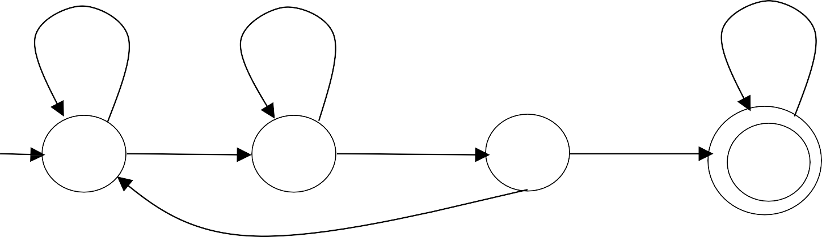
Turing Machine Example
Input alphabet Σ = {a,b }
Accepts the language: (a + b)*aba(a + b)*
DFA:
b
a
a, b
q₀
a
b
a
q₁
q₂
q _{f}
b

Slide 61
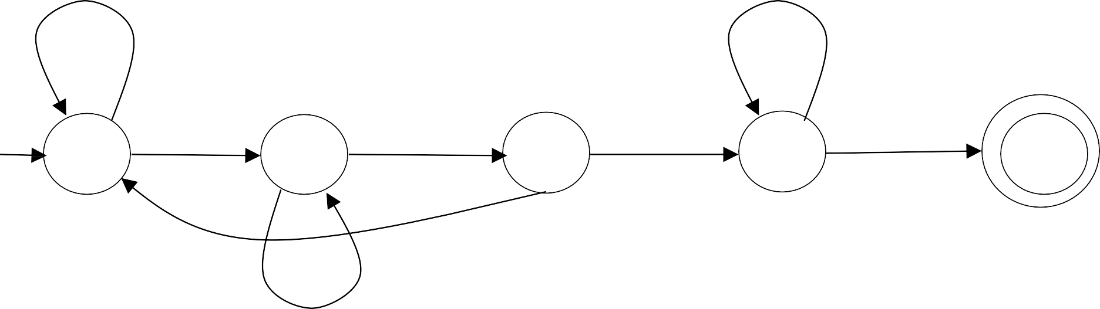
Turing Machine Example
Input alphabet Σ = {a,b }
Accepts the language: (a + b)*aba(a + b)*
q_{r}
◊ → ◊, R
b → b, R
b → b, R
a → a, R
◊ → ◊, R
◊ → ◊, R
a → a, R
q
b → b, R
a → a, R
◊ → ◊, L
q
q
q
q
0
1
2
3
f
b → b, R
a → a, R

Slide 62
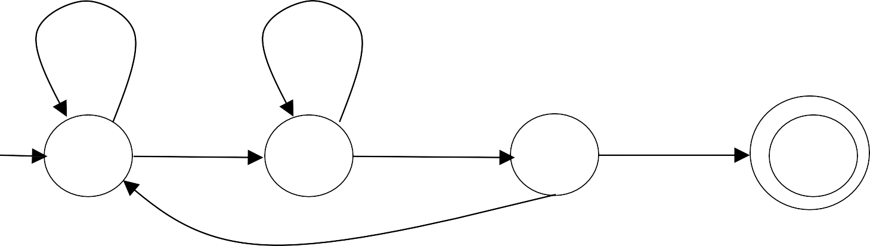
Simplified Diagram
Accepts the language: (a + b)*aba(a + b)*
b → b, R
a → a, R
a → a, R
q
b → b, R
a → a, R
q
q
q
0
1
2
f
b → b, R

Slide 63
Accepts the language:
{a^{m} | m is odd }
a → a, R
a → a, R
q₀
q₁
q₂
◊ → ◊, L
a → a, R
q _{f}

Slide 64
Turing Machine Example
Input alphabet Σ = {a,b }
Accepts the language: (a + b)*aba
b → b, R
a → a, R
a → a, R
a → a, R
q
b → b, R
a → a, R
◊ → ◊, L
q
q
q
q
0
1
2
3
f
b → b, R
b → b, R

Slide 65
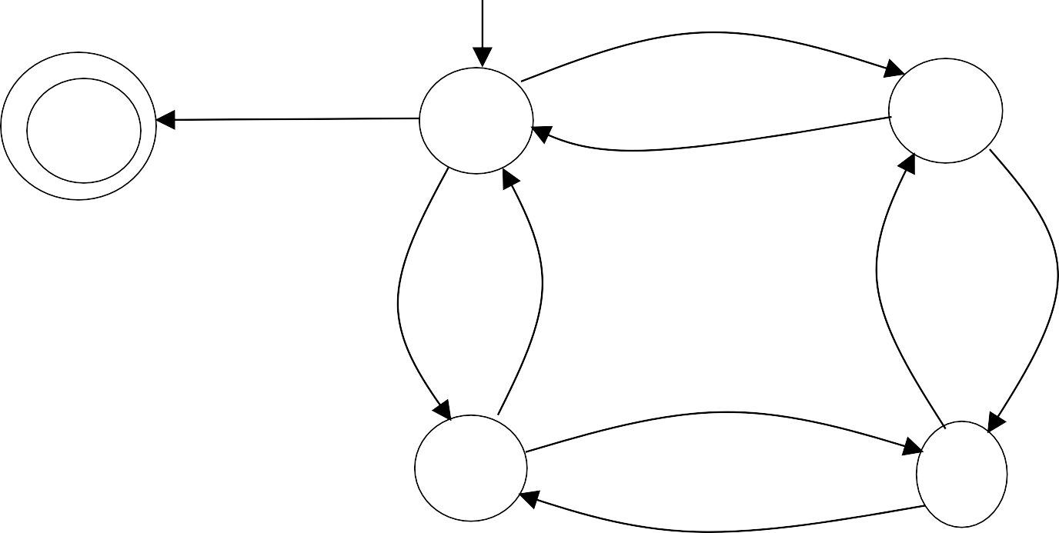
Design TM for the language of even number of 1’s and even number of 0’s over ∑={0,1}
0 → 0, R
◊ → ◊, L
q₂
q
q₀
f
0 → 0, R
1 →1, R
1 →1, R
1 →1, R
1 →1, R
0 → 0, R
q₁
q₃
0 → 0, R

Slide 66
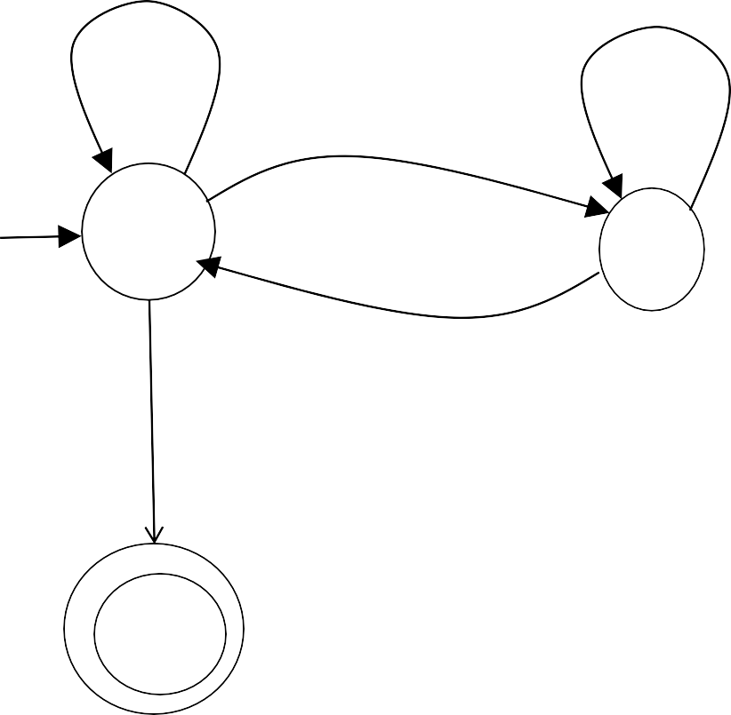
Design a Turing Machine to recognize Language consisting of
string having any number of 0’s & even number of l’s over ∑=
{0, 1}. (05 Marks Nov-2016(2012 Pattern) EndSem)
0 → 0, R
0 → 0, R
1 → 1, R
q₀
q₁
1 → 1, R
◊ → ◊, R
q _{f}

Slide 67
Design TM to accept the set L of all strings formed with 0&1 and having substring 000. (08 Marks May- 2013(2003 Pattern) EndSem)
1 → 1, R
0 → 0, R
1 → 1, R
0 → 0, R
0 → 0, R
q₀
q₁
q
q _{f}
2
1 → 1, R

Slide 68
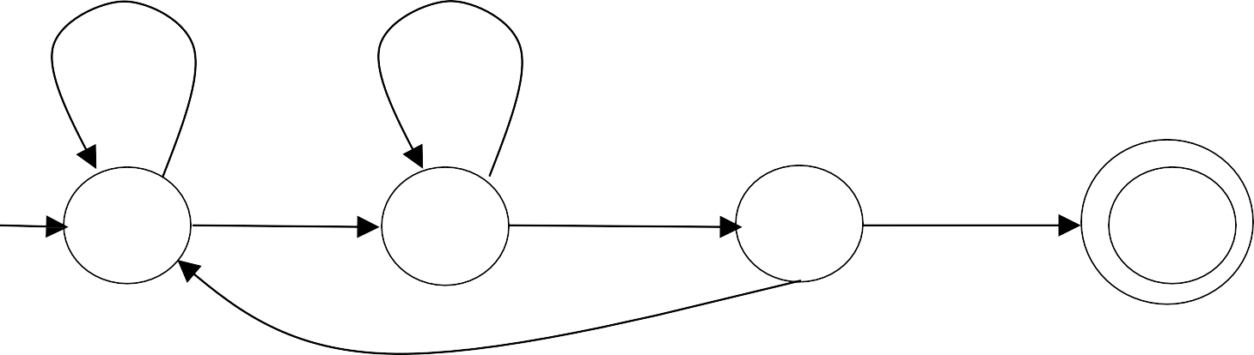
Design a TM that recognizes a string containing aba
as a substring.
(06 Marks Nov-2014 (2012 Pattern) EndSem)
Design a turing machine that accepts the language of
all strings which contain ‘aba’ as a substring. (04 Nov-2015(2012 Pattern) EndSem)
Mark
b → b, R
a → a, R
a → a, R
q
b → b, R
a → a, R
q
q
q
0
1
2
f
b → b, R

Slide 69
RECALL
1. Design of Turing Machine for various problem

Slide 70
Turing Machine Example
Input alphabet
Σ = {a,b}
Design TM for the language L={a^{n}b^{n}|n≥1} over ∑
Y → Y , L
Y → Y , R
a → a, R
a → a, L
q₀
Y → Y , R
a → X , R
q₁
b → Y , L
q₂
X → X , R
◊ → ◊, L
q _{f}
Y → Y , R
q₃

Slide 71
Example
 | ◊ | ◊ | a | a | b | b | ◊ | ◊
Y → Y , R
a → a, R
Y → Y , L
a → a, L
q₀
Y → Y , R
a → X , R
q₁
b → Y , L
q₂
X → X , R
◊ → ◊, L
q _{f}
Y → Y , R
q₃

Slide 72
Time 0
 | ◊ | ◊ | a | a | b | b | ◊ | ◊
q₀
Y → Y , R
a → a, R
Y → Y , L
a → a, L
q₀
Y → Y , R
a → X , R
q₁
b → Y , L
q₂
X → X , R
◊ → ◊, L
q _{f}
Y → Y , R
q₃

Slide 73
Time 1
 | ◊ | ◊ | X | a | b | b | ◊ | ◊
q₁
Y → Y , R
a → a, R
Y → Y , L
a → a, L
a → X , R
q₁
b → Y , L
q₂
q₀
Y → Y , R
X → X , R
◊ → ◊, L
q _{f}
Y → Y , R
q₃

Slide 74
Time 2
 | ◊ | ◊ | X | a | b | b | ◊ | ◊
q₁
Y → Y , R
a → a, R
Y → Y , L
a → a, L
a → X , R
q₁
b → Y , L
q₂
q₀
Y → Y , R
X → X , R
◊ → ◊, L
q _{f}
Y → Y , R
q₃

Slide 75
Time 3
 | ◊ | ◊ | X | a | Y | b | ◊ | ◊
q₂
Y → Y , R
a → a, R
Y → Y , L
a → a, L
a → X , R
q₁
b → Y , L
q₂
q₀
Y → Y , R
X → X , R
◊ → ◊, L
q _{f}
Y → Y , R
q₃

Slide 76
Time 4
 | ◊ | ◊ | X | a | Y | b | ◊ | ◊
q₂
Y → Y , R
a → a, R
Y → Y , L
a → a, L
a → X , R
q₁
b → Y , L
q₂
q₀
Y → Y , R
X → X , R
◊ → ◊, L
q _{f}
Y → Y , R
q₃

Slide 77
Time 5
 | ◊ | ◊ | X | a | Y | b | ◊ | ◊
q₀
Y → Y , R
a → a, R
Y → Y , L
a → a, L
a → X , R
q₁
b → Y , L
q₂
q₀
Y → Y , R
X → X , R
◊ → ◊, L
q _{f}
Y → Y , R
q₃

Slide 78
Time 6
 | ◊ | ◊ | X | X | Y | b | ◊ | ◊
q₁
Y → Y , R
a → a, R
Y → Y , L
a → a, L
a → X , R
q₁
b → Y , L
q₂
q₀
Y → Y , R
X → X , R
◊ → ◊, L
q _{f}
Y → Y , R
q₃

Slide 79
Time 7
 | ◊ | ◊ | X | X | Y | b | ◊ | ◊
q₁
Y → Y , R
a → a, R
Y → Y , L
a → a, L
a → X , R
q₁
b → Y , L
q₂
q₀
Y → Y , R
X → X , R
◊ → ◊, L
q _{f}
Y → Y , R
q₃

Slide 80
Time 8
 | ◊ | ◊ | X | X | Y | Y | ◊ | ◊
q₂
Y → Y , R
a → a, R
Y → Y , L
a → a, L
a → X , R
q₁
b → Y , L
q₂
q₀
Y → Y , R
X → X , R
◊ → ◊, L
q _{f}
Y → Y , R
q₃

Slide 81
Time 9
 | ◊ | ◊ | X | X | Y | Y | ◊ | ◊
q₂
Y → Y , R
a → a, R
Y → Y , L
a → a, L
a → X , R
q₁
b → Y , L
q₂
q₀
Y → Y , R
X → X , R
◊ → ◊, L
q _{f}
Y → Y , R
q₃

Slide 82
Time 10
 | ◊ | ◊ | X | X | Y | Y | ◊ | ◊
q₀
Y → Y , R
a → a, R
Y → Y , L
a → a, L
a → X , R
q₁
b → Y , L
q₂
q₀
Y → Y , R
X → X , R
◊ → ◊, L
q _{f}
q₃
Y → Y , R

Slide 83
Time 11
 | ◊ | ◊ | X | X | Y | Y | ◊ | ◊
q₃
Y → Y , R
a → a, R
Y → Y , L
a → a, L
a → X , R
q₁
b → Y , L
q₂
q₀
Y → Y , R
X → X , R
◊ → ◊, L
q _{f}
q₃
Y → Y , R

Slide 84

Time 10
 | ◊ | ◊ | X | X | Y | Y | ◊ | ◊
q _{f}
Y → Y , L
a → a, L
Y → Y , R
a → a, R
a → X , R
q₁
b → Y , L
q₂
q₀
Y → Y , R
X → X , R
◊ → ◊, L
q₃
Y → Y , R
Halt & Accept

Slide 85
Example
 | ◊ | ◊ | a | a | b | ◊ | ◊ | ◊
Y → Y , R
a → a, R
Y → Y , L
a → a, L
q₀
Y → Y , R
a → X , R
q₁
b → Y , L
q₂
X → X , R
◊ → ◊, L
q _{f}
Y → Y , R
q₃

Slide 86
Time 0
 | ◊ | ◊ | a | a | b | ◊ | ◊ | ◊
q₀
Y → Y , R
a → a, R
Y → Y , L
a → a, L
q₀
Y → Y , R
a → X , R
q₁
b → Y , L
q₂
X → X , R
◊ → ◊, L
q _{f}
Y → Y , R
q₃

Slide 87
Time 1
 | ◊ | ◊ | X | a | b | ◊ | ◊ | ◊
q₁
Y → Y , R
a → a, R
Y → Y , L
a → a, L
a → X , R
q₁
b → Y , L
q₂
q₀
Y → Y , R
X → X , R
◊ → ◊, L
q _{f}
Y → Y , R
q₃

Slide 88
Time 2
 | ◊ | ◊ | X | a | b | ◊ | ◊ | ◊
q₁
Y → Y , R
a → a, R
Y → Y , L
a → a, L
a → X , R
q₁
b → Y , L
q₂
q₀
Y → Y , R
X → X , R
◊ → ◊, L
q _{f}
Y → Y , R
q₃

Slide 89
Time 3
 | ◊ | ◊ | X | a | Y | ◊ | ◊ | ◊
q₂
Y → Y , R
a → a, R
Y → Y , L
a → a, L
a → X , R
q₁
b → Y , L
q₂
q₀
Y → Y , R
X → X , R
◊ → ◊, L
q _{f}
Y → Y , R
q₃

Slide 90
Time 4
 | ◊ | ◊ | X | a | Y | ◊ | ◊ | ◊
q₂
Y → Y , R
a → a, R
Y → Y , L
a → a, L
a → X , R
q₁
b → Y , L
q₂
q₀
Y → Y , R
X → X , R
◊ → ◊, L
q _{f}
Y → Y , R
q₃

Slide 91
Time 5
 | ◊ | ◊ | X | a | Y | ◊ | ◊ | ◊
q₀
Y → Y , R
a → a, R
Y → Y , L
a → a, L
a → X , R
q₁
b → Y , L
q₂
q₀
Y → Y , R
X → X , R
◊ → ◊, L
q _{f}
Y → Y , R
q₃

Slide 92
Time 6
 | ◊ | ◊ | X | X | Y | ◊ | ◊ | ◊
q₁
Y → Y , R
a → a, R
Y → Y , L
a → a, L
a → X , R
q₁
b → Y , L
q₂
q₀
Y → Y , R
X → X , R
◊ → ◊, L
q _{f}
Y → Y , R
q₃

Slide 93
Time 7
 | ◊ | ◊ | X | X | Y | ◊ | ◊ | ◊
q₁
Y → Y , R
a → a, R
Y → Y , L
a → a, L
a → X , R
q₁
b → Y , L
q₂
q₀
Y → Y , R
X → X , R
◊ → ◊, L
q _{f}
Y → Y , R
q₃

Slide 94
Time 7
 | ◊ | ◊ | X | X | Y | ◊ | ◊ | ◊
q₁
No possible Transition_{Y → Y , R}
Y → Y , L
a → a, L
Halt & Reject
a → a, R
a → X , R
q₁
b → Y , L
q₂
q₀
Y → Y , R
X → X , R
◊ → ◊, L
q _{f}
Y → Y , R
q₃

Slide 95
Turing Machine Example
Input alphabet
Σ = {a,b}
Design TM for the language L={a^{n}b^{n+1}|n≥1} over ∑
Y → Y , L
Y → Y , R
a → a, R
a → a, L
q₀
Y → Y , R
a → X , R
q₁
b → Y , L
q₂
X → X , R
q₃
b → ◊, R
◊ → ◊, L
Y → Y , R
q₄
q _{f}

Slide 96
Recursive Enumerable (RE) or Type -0 Language
RE languages or type-0 languages are generated by type-0 grammars.
An RE language can be accepted or recognized by Turing machine which means it will enter into final state for the strings of language and may or may not enter into rejecting state for the strings which are not part of the language.
It means TM can loop forever for the strings which are not a part of the language.
RE languages are also called as Turing recognizable languages.

Slide 97
Recursive language(REC)
A recursive language (subset of RE) can be decided by Turing machine which means it will enter into final state for the strings of language and rejecting state for the strings which are not part of the language.
e.g.; L= {a^{n}b^{n}c^{n}|n>=1} is recursive because we can construct a turing machine which will move to final state if the string is of the form a^{n}b^{n}c^{n} else move to non-final state.
So the TM will always halt in this case.
REC languages are also called as Turing decidable languages.

Slide 98
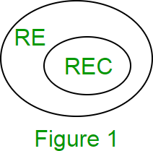
The relationship between RE and REC languages can be shown in Following Figure

Slide 99
Design TM for the language L={a^{n}b^{n}c^{n}|n≥1} over ∑={a ,b, c}. (10 Marks May-2018 EndSem)
Z → Z, L
b → b, L
Y → Y , L
a → a, L
b → b, R Z → Z, R
Y → Y , R
a → a, R
a → X , R
b → Y , R
q₂
c → Z, L
q₃
q₀
Y → Y , R
q₁
X → X , R
q₄
◊ → ◊, L
Y → Y , R
Z → Z, R
q _{f}

Slide 100
Design a Turing Machine to recognize the language
L = {l^{n} 2^{n} 3^{n} | n>=l}. Simulate TM for “ll2233”. (10 Marks
May-2017(2012 Pattern) EndSem)
Z → Z, L
2 → 2, L
Y → Y , L
1 → 1, L
2 → 2, L Z → Z, R
Y → Y , R
1 → 1, R
1 → X , R
2 → Y , R
q₂
3 → Z, L
q₃
q₀
Y → Y , R
q₁
X → X , R
q₄
◊ → ◊, L
Y → Y , R
Z → Z, R
q _{f}

Slide 101
RECALL
1. Design of Turing Machine for various problem

Slide 102
Design TM for the language L={WW^{R}|W€∑*}
over ∑={a,b} (08 Marks May-2013(2003 Pattern) EndSem)
b → b, R a → a, R
q _{f}
◊ → ◊, L
q₂
◊ → ◊, R
q₁
a → ◊, R
a → ◊, L
q₃
q₀
◊ → ◊, R
b → b, L
b → ◊, R
a → a, L
q
◊ → ◊, L
q
b → ◊, L
1
2
b → b, R a → a, R

Slide 103
Define Turing Machine and construct a TM which recognizes
strings consisting of equal no. of a’s and b’s.
(08 Marks May-2015 endsem)
Y → Y , R
a → a, R
b → b, L a → a, L Y → Y , L
q _{f}
q
b → Y , L
q
◊ → ◊, R
1
2
a → X , R
X → X , R
q₀
X → X , R
Y → Y , R
b → X , R
q₁
q₂
a → Y , L
b → b, L a → a, L Y → Y , L
b → b, R Y → Y , R

Slide 104
b → b, L a → a, L
Y → Y , L
# →#, L
q _{f}
b → b, R a → a, R
◊ → ◊, R
q₇
Y → Y , R
Y → Y , R
a → X , R
q₁
a → Y , L
q₃
# →#, R
# →#, R
q₂
X → X , R
X → X , R
q
0
b → X , R
q₄
q₅
b → Y , L
q₇
# →#, R
# →#, L
b → b, R
a → a, R
b → b, L a → a, L Y → Y , L
Y → Y , R

Slide 105
Design Turing machine (TM) M that recognizes A = {{ a^{i}b^{j}c^{k} | i x j = k and i,j,k≥1} }

Slide 106
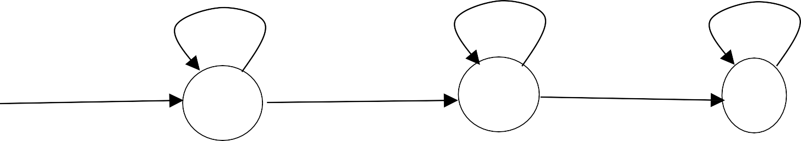
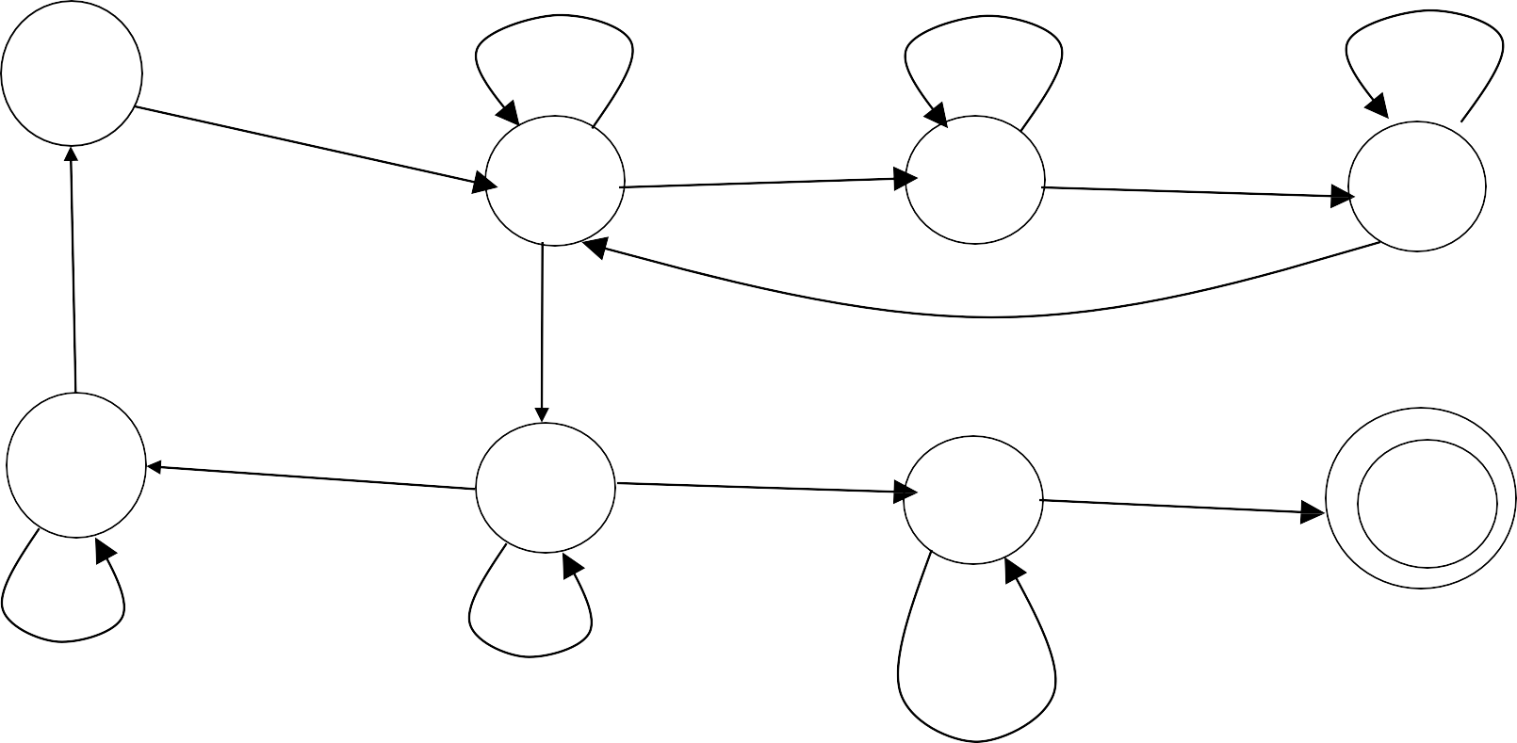
a → a, R
b → b, R
c → c, R
q₀
a → a, L
b → b, L
c → c, L
a → a, R
b → b, R
q₂
c → c, R
q₃
q₁
q
◊ → ◊, L
4
z → z, L b → b, L
◊ → ◊, R
a → X , R
b → b, R z → z, R
a → a, R
q₀
q₁
z → z, L
b → Y , R
c → Z, L
q
q
2
3
X → X , R
q₄
Y → Y , R
q₅
◊ → ◊, R
q₆
q _{f}
a → a, L
X → X , R
a → a, L
Y → b, L
z → z, R b → b, R

Slide 107
Design Turing machine (TM) M that recognizes A = {ww|w€{a,b}*},

Slide 108
Computing Functions with
Turing Machines

Slide 109
f (w)
A function
has:
Domain: D
Result Region: S
f (w)
w∈ D
f (w) ∈ S

Slide 110
A function may have many parameters:
Addition function
f (x, y) = x + y
Example:

Slide 111
Integer Domain
Decimal: 5
Binary: 101
Unary: 11111
We prefer unary representation:
easier to manipulate with Turing machines

Slide 112
A function f
Definition:
is computable if
M
there is a Turing Machine such that:
Initial configuration
Final configuration
 | ◊ | w | ◊
 | ◊ | f (w) | ◊
q₀
initial state
q _{f}
accept state
For all w∈ D Domain

Slide 113
f is computable if
In other words:
A function
M
there is a Turing Machine such that:
∗
q₀ w 
q _{f} f (w)
Initial Configuration
Final Configuration
For all w∈ D Domain

Slide 114
Construct TM for obtaining 1’s complement of a
binary number. Simulate TM for any input.
1 → 0, L
0 → 1, L
1 → 1, R
0 → 0, R
◊ → ◊, L
1 → 0, L
0 → 1, L
◊ → ◊, L
q
q _{f}
q
q
0
1
2

Slide 115
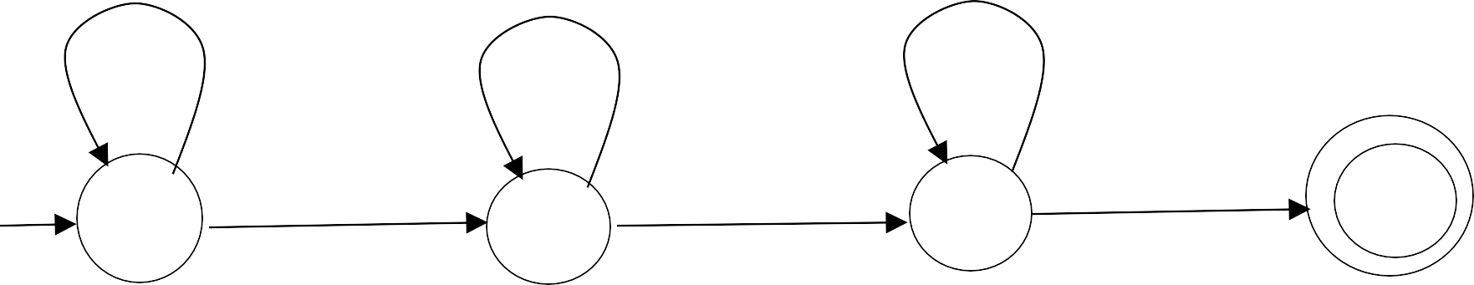
Construct TM for obtaining 2’s complement of a
binary number. Simulate TM for any input.
(08 Marks May-2018(2012 Pattern)
06 Marks Nov-2017(2015 pattern) EndSem) (08 Marks May-2016(2012 Pattern) EndSem) (08 Marks Nov-2014(2008 Pattern) EndSem) (08 Marks Nov-2015(2012 Pattern) EndSem) (08 Marks May-2016(2008 Pattern) EndSem)
0 → 1, L
1 → 0, L
1 → 1, R
0 → 0, R
0 → 0, L
◊ → ◊, L
1 → 1, L
◊ → ◊, L
q
q _{f}
q
q
0
1
2

Slide 116
Construct TM to replace string 110 by 101 in binary input string over the ∑={0,1}. (08 Marks Nov-2016(2012 Pattern) EndSem)
q _{f}
◊ → ◊, L
◊ → ◊, L
◊ → ◊, L
0 → 0, R
1 →1, R
q₀
1 →1, R
q₁
1 →1, R
0 → 1, L
q₃
q₂
0 → 0, R
1 → 0, R
1 →1, R
q₄

Slide 117
Design Turing
mach_{n}ine (TM) M that
recognizes A = {0² |n≥0}, the language consisting of all strings of 0s whose length is a power of 2.

Slide 118
The function f (x, y) = x + y
Example
is computable
x, y
are integers
Turing Machine:
Input string:
x0 y
unary
Output string: xy0
unary

Slide 119
y
x
 | ◊ | 1 | 1 |  | 1 | 0 | 1 |  | 1 | ◊
Start
q₀
initial state
The 0 is the delimiter that separates the two numbers

Slide 120
x
y
Start
 | ◊ | 1 | 1 |  | 1 | 0 | 1 |  | 1 | ◊
q₀
initial state
x + y
Finish
 | ◊ | 1 | 1 |  | 1 | 1 | 0 | ◊
q _{f}
final state

Slide 121
The 0 here helps when we use the result for other operations
x + y
Finish
 | ◊ | 1 | 1 |  | 1 | 1 | 0 | ◊
q _{f}
final state

Slide 122
Design a Turing Machine to add two unary numbers. (08 Marks Nov-
2016(2012 Pattern) EndSem)
Design a TM that adds two unary numbers. Show stepwise functioning of TM for the input: ll + lll. (10 Marks Nov-2016(2012 Pattern) EndSem)
Design a Turing machine to add two unary numbers. (08 Marks Nov-
2016(2008 Pattern) EndSem)
Design a TM to add two unary numbers. (08 Marks Nov-2014
(2012 Pattern) EndSem)

Slide 123
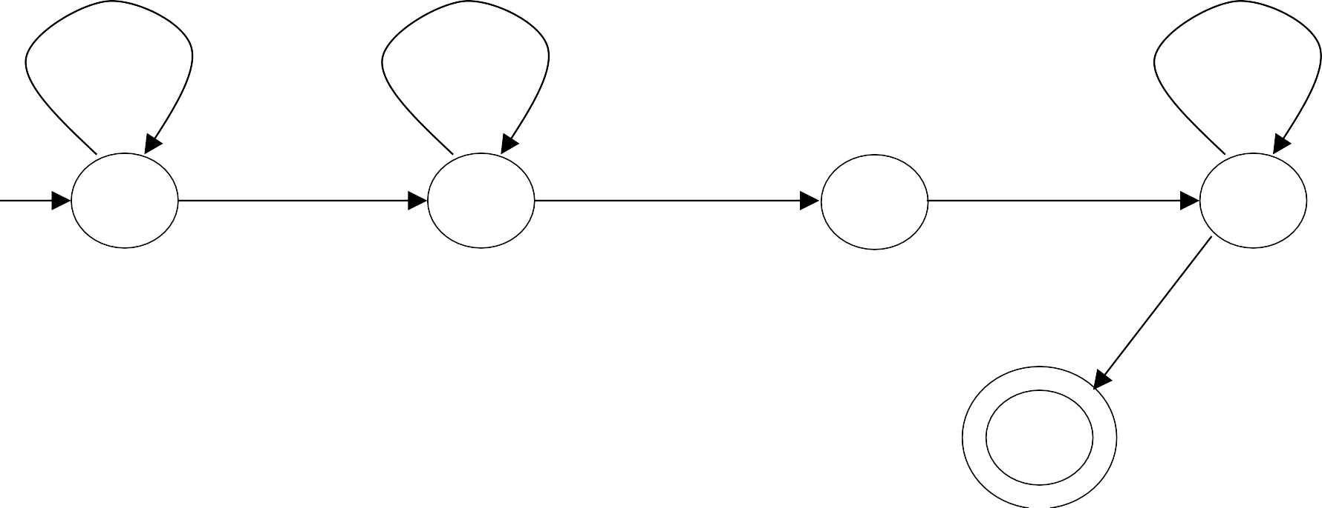
f (x, y) = x + y
Turing machine for function
1 →1, R
1 →1, R
1 →1, L
_{q0} 0 →1, R _{q1} ◊ → ◊, L
1 → ◊, L
q₂
q₃
◊ → ◊, R
q₄

Slide 124
Execution Example:
Time 0
y
x
x = 11
y = 11
(=2)
 | ◊ | 1 | 1 | 0 | 1 | 1 | ◊
(=2)
q₀
Final Result
x + y
q₄
 | ◊ | 1 | 1 | 1 | 1 | ◊ | ◊

Slide 125
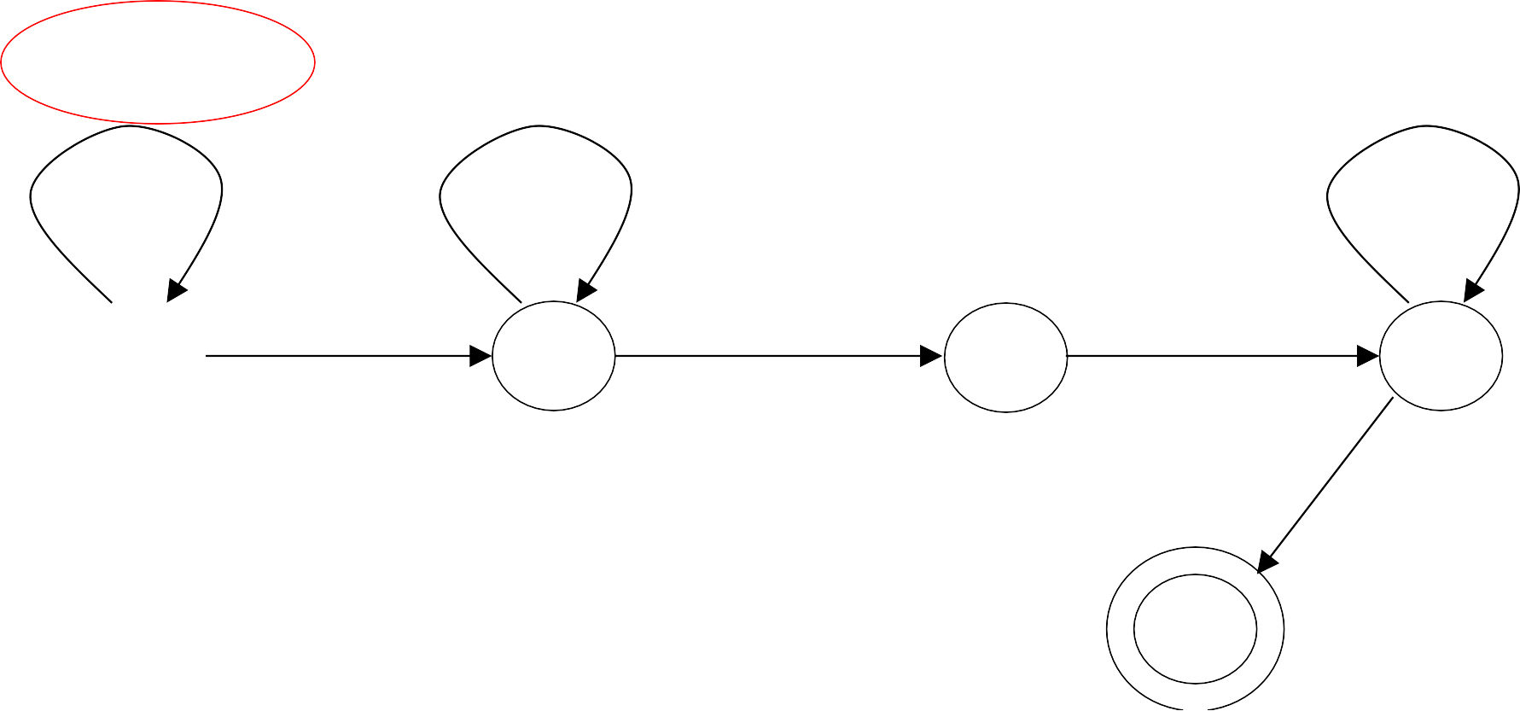
Time 0
q₀
 | ◊ | 1 | 1 | 0 | 1 | 1 | ◊
1 →1, R
1 →1, R
1 →1, L
_{q0} 0 →1, R _{q1} ◊ → ◊, L
q₂
1 → ◊, L
q₃
◊ → ◊, R
q₄

Slide 126
 | ◊ | 1 | 1 | 0 | 1 | 1 | ◊
Time 1
q₀
1 →1, R
1 →1, R
1 →1, L
_{q0} 0 →1, R _{q1} ◊ → ◊, L
q₂
1 → ◊, L
q₃
◊ → ◊, R
q₄

Slide 127
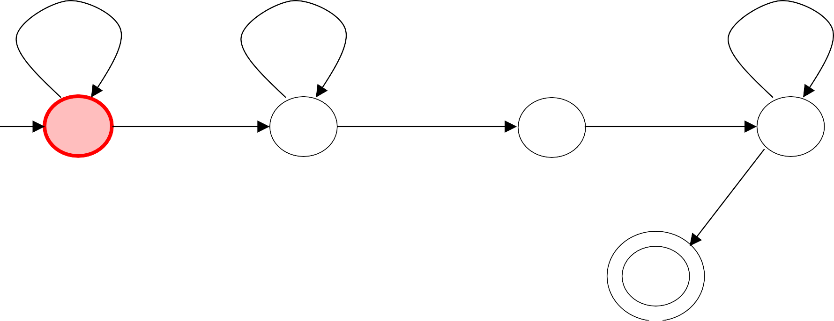
Time 2
 | ◊ | 1 | 1 | 0 | 1 | 1 | ◊
q₀
1 →1, R
1 →1, R
1 →1, L
_{q0} 0 →1, R _{q1} ◊ → ◊, L
q₂
1 → ◊, L
q₃
◊ → ◊, R
q₄

Slide 128
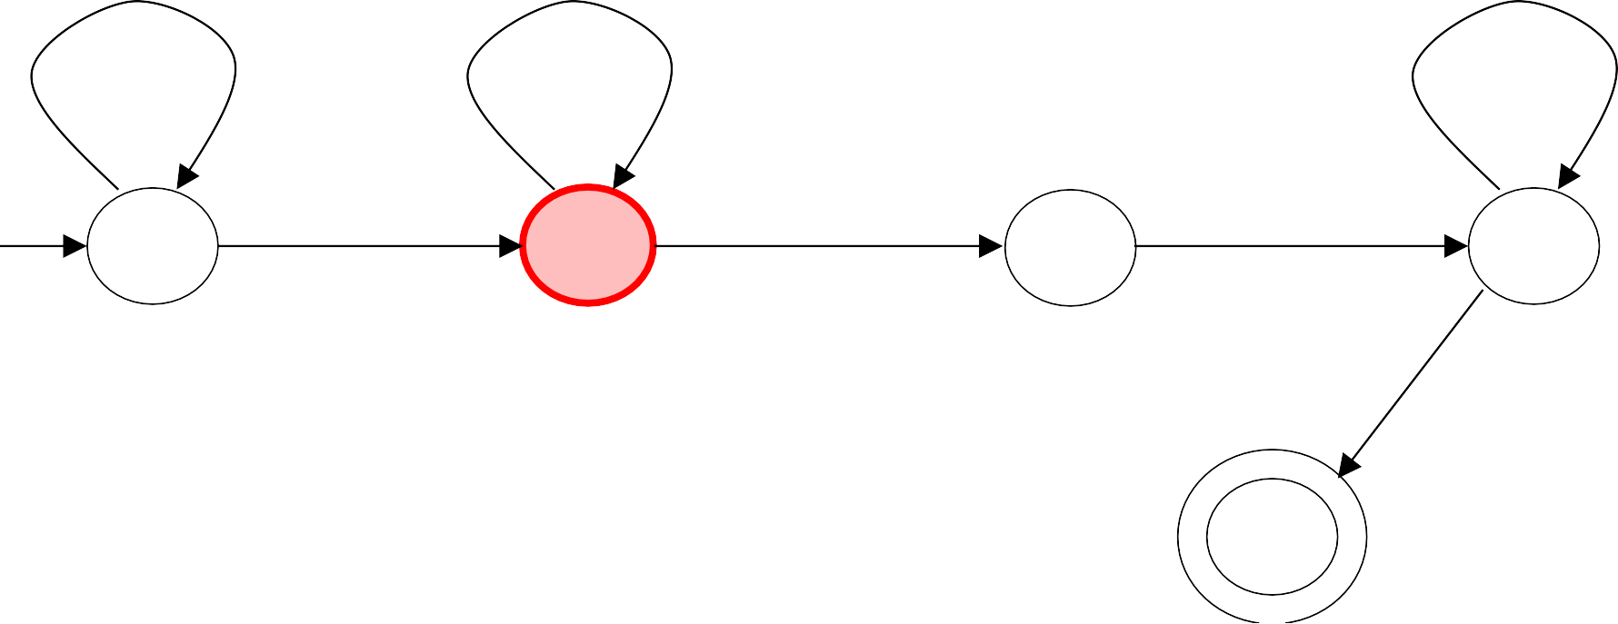
Time 3
 | ◊ | 1 | 1 | 1 | 1 | 1 | ◊
q₁
1 →1, R
1 →1, R
1 →1, L
_{q0} 0 →1, R _{q1} ◊ → ◊, L
q₂
1 → ◊, L
q₃
◊ → ◊, R
q₄

Slide 129
Time 4
 | ◊ | 1 | 1 | 1 | 1 | 1 | ◊
q₁
1 →1, R
1 →1, R
1 →1, L
_{q0} 0 →1, R _{q1} ◊ → ◊, L
q₂
1 → ◊, L
q₃
◊ → ◊, R
q₄

Slide 130
Time 5
 | ◊ | 1 | 1 | 1 | 1 | 1 | ◊
q₁
1 →1, R
1 →1, R
1 →1, L
_{q0} 0 →1, R _{q1} ◊ → ◊, L
q₂
1 → ◊, L
q₃
◊ → ◊, R
q₄

Slide 131
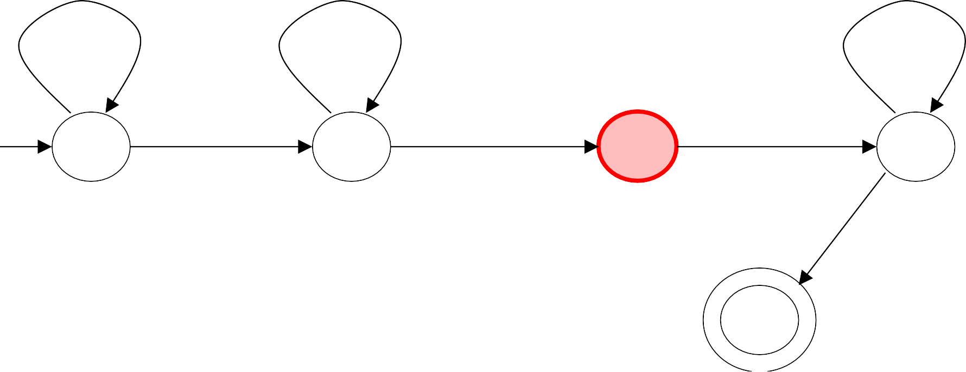
Time 6
 | ◊ | 1 | 1 | 1 | 1 | 1 | ◊
q₂
1 →1, R
1 →1, R
1 →1, L
_{q0} 0 →1, R _{q1} ◊ → ◊, L
q₂
1 → ◊, L
q₃
◊ → ◊, R
q₄

Slide 132
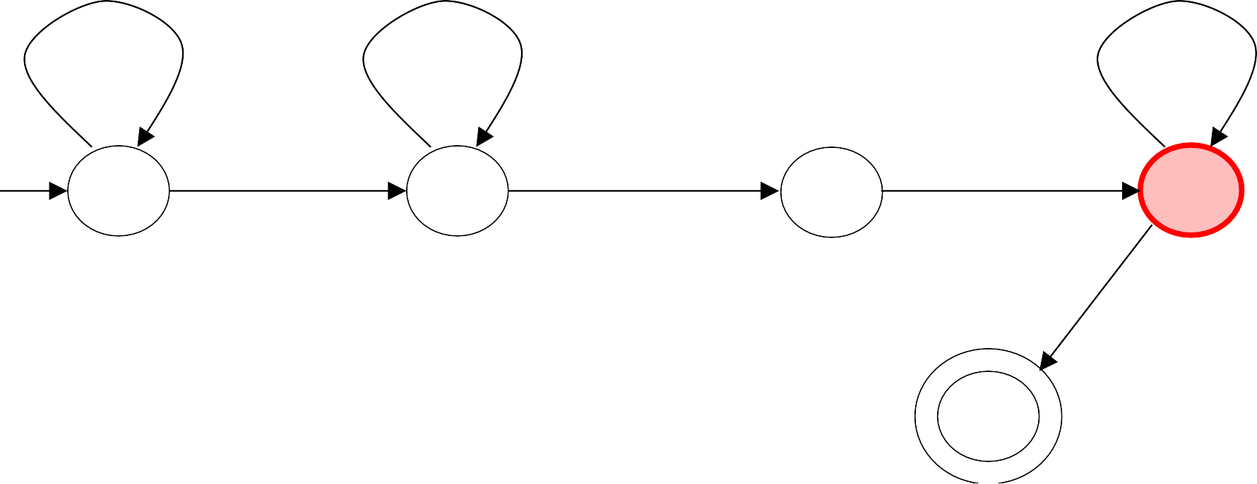
Time 7
 | ◊ | 1 | 1 | 1 | 1 | ◊ | ◊
q₃
1 →1, R
1 →1, R
1 →1, L
_{q0} 0 →1, R _{q1} ◊ → ◊, L
q₂
1 → ◊, L
q₃
◊ → ◊, R
q₄

Slide 133
Time 8
 | ◊ | 1 | 1 | 1 | 1 | ◊ | ◊
q₃
1 →1, R
1 →1, R
1 →1, L
_{q0} 0 →1, R _{q1} ◊ → ◊, L
q₂
1 → ◊, L
q₃
◊ → ◊, R
q₄

Slide 134
 | ◊ | 1 | 1 | 1 | 1 | ◊ | ◊
Time 9
q₃
1 →1, R
1 →1, R
1 →1, L
_{q0} 0 →1, R _{q1} ◊ → ◊, L
q₂
1 → ◊, L
q₃
◊ → ◊, R
q₄

Slide 135
Time 10
q₃
 | ◊ | 1 | 1 | 1 | 1 | ◊ | ◊
1 →1, R
1 →1, R
1 →1, L
_{q0} 0 →1, R _{q1} ◊ → ◊, L
q₂
1 → ◊, L
q₃
◊ → ◊, R
q₄

Slide 136
Time 11
q₃
 | ◊ | 1 | 1 | 1 | 1 | ◊ | ◊
1 →1, R
1 →1, R
1 →1, L
_{q0} 0 →1, R _{q1} ◊ → ◊, L
q₂
1 → ◊, L
q₃
◊ → ◊, R
q₄

Slide 137
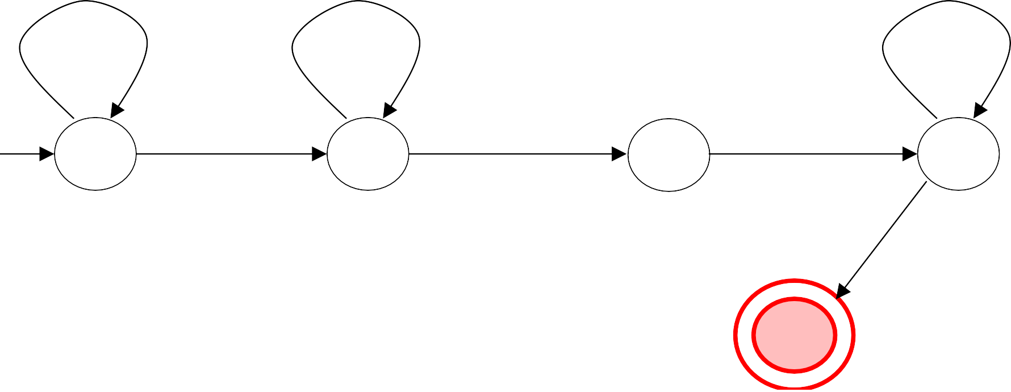
Time 12
q₄
 | ◊ | 1 | 1 | 1 | 1 | ◊ | ◊
1 →1, R
1 →1, R
1 →1, L
_{q0} 0 →1, R _{q1} ◊ → ◊, L
q₂
1 → ◊, L
q₃
◊ → ◊, R
HALT & accept
q₄

Slide 138
Another Example
The function
f (x, y) = x − y
is computable
x, y
are integers
Turing Machine:
Input string:
x0 y
unary
Output string: xy0
unary

Slide 139
Design a Turing Machine to subtract two unary numbers.
Construct a TM to compute
f (a, b) = a − b
= 0
where a > b where a < b
(10 Marks Nov-2017 EndSem)

Slide 140
Turing machine for function f (x, y) = x − y
q _{f}
1 →1, R
1 →1, R
0 → 1, L
_{q0} 1 → ◊, R
0 → 0, R
0 → 0, R
q₂ ◊ → ◊, L
q₁
q₃
1 → ◊, L
q₄
1 → 1, L
0 → 0, L
◊ → ◊, R
q
◊ → ◊, R
q
5
f
1 → ◊, R

Slide 141
Design a TM which compares two positive integers m & n and produces output Gt if m > n ; Lt if m < n; and Eq if m = n ; Write simulation for the input
m = l, n = 2.
m = n = 2
(12 Marks May-2018 EndSem)

Slide 142
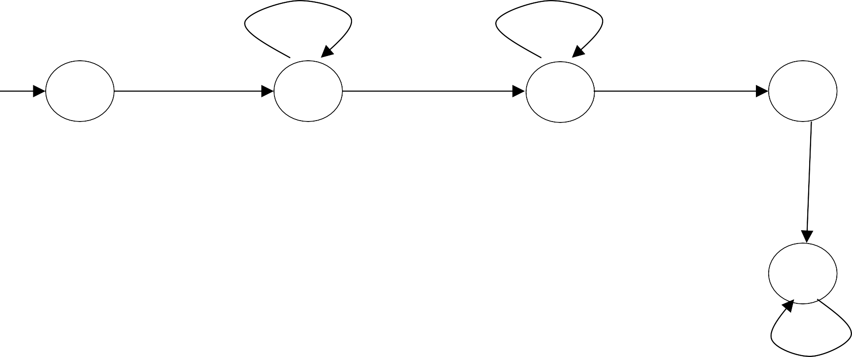
q _{f}
1 →1, R
1 →1, R
0 → Gt, R
_{q0} 1 → ◊, R
0 → 0, R
q₅
0 → 0, R
q₂ ◊ → ◊, L
q₁
q₃
1 → ◊, L
q₄
1 → 1, L
0 → 0, L
◊ → ◊, R
→ Eq, R
q _{f}
1 → Lt, R
q _{f}

Slide 143
Design a TM to find the value of log₂ (n) where n is any binary number & a perfect power of 2.
(08 Marks May-2018 EndSem)
0 → 1, R
q
1 → ◊, R
q
0 → 1, R
q₂ ◊ → ◊, L
0
1
q
f

Slide 144
Another Example
The function
f (x, y) = x * y
is computable
x, y
are integers
Turing Machine:
Input string:
x0 y
unary
Output string: xy0
unary

Slide 145
Design a TM that multiplies two unary numbers. Write simulation for the strings. ll & lll. (10 Marks Nov-2017 EndSem)

Slide 146
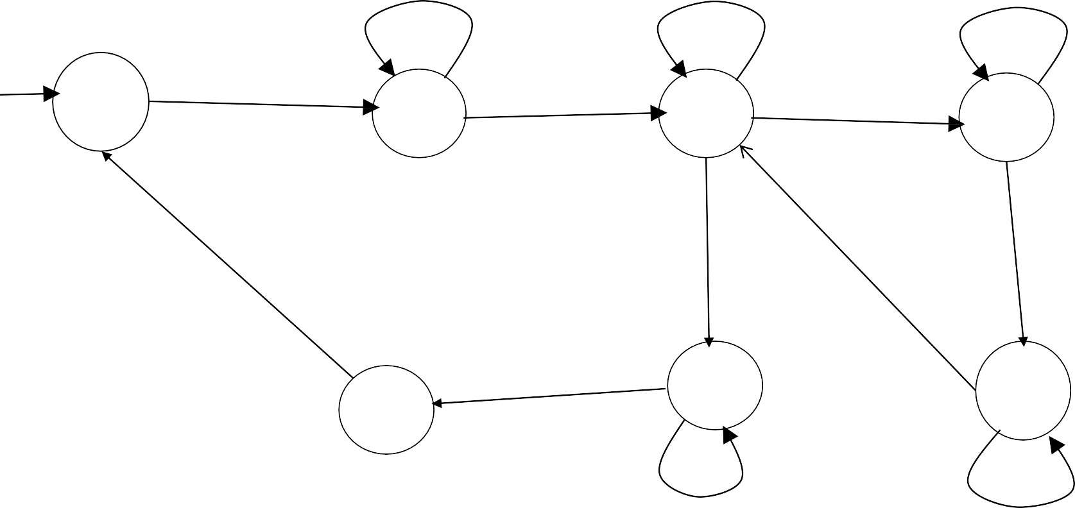
X → X , R
1 → 1, R
◊ → ◊, R
1 → 1, R
1 → ◊, R
q
1 → ◊, R
q
0 → 0, R
q
q
0
1
2
3
→ X , L
◊ → ◊, R
0 → 0, R
X → X , L
0 → ◊, R
q₅
q₄
q₆
0 → 0, L
→ 1, L
1 → 1, L
q
1 → 1, L
7
◊ → ◊, L
X → X , L
X → 1, R
q
1 → ◊, R
q
8
◊ → ◊, L
f
X → 1, R

Slide 147
Construct TM for the following:
Language consisting of string having any number of 0’s & even number of l’s over ∑= {0, 1}.
Increment the value of any binary number by one. (10 Marks Nov-2016(2012 Pattern) EndSem)
0 → 0, R
1 → 1, R
0 → 0, L
1 → 1, L
◊ → ◊, L _{q}
q₂
◊ → ◊, L
q
0 → 1, L
q
0
1
f
1 → 0, L
0 → 1, L
q₃
q _{f}
1 → 0, L
→ 1, L

Slide 148
RECALL
1. Computing Functions with Turing Machines

Slide 149
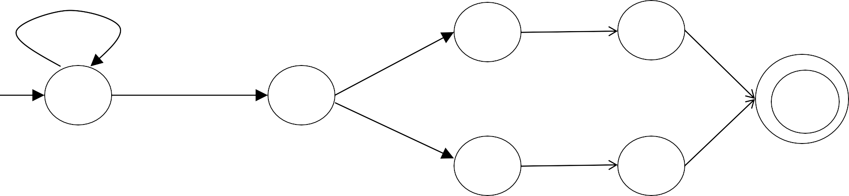
Construct a
Turing machine to perform mod 2
operation on given binary number as well as store separated by blank.
number retain original result after number
(08 Marks May-2016(2012 Pattern) EndSem)
0 → 0, R
1 → 1, R
_{q} ◊ → ◊, R _{q}
0 → 0, R
2
→ 0, R
4
◊ → ◊, L _{q}
q
1
1 → 1, R
0
q
f
q₃ q₅
◊ → ◊, R
→ 1, R

Slide 150
Another Example
f (x) = 2x
x
The function
is computable
is integer
Turing Machine:
Input string:
x
unary
Output string:
xx
unary

Slide 151
x
Start
 | ◊ | 1 | 1 |  | 1 | ◊
q₀
initial state
2x
Finish
 | ◊ | 1 | 1 |  | 1 | 1 | 1 | ◊
q _{f}
accept state

Slide 152
f (x) = 2x
Turing Machine Pseudocode for
Replace every 1 with $
Repeat:
Find rightmost $, replace it with 1
Go to right end, insert 1 Until no more $ remain

Slide 153
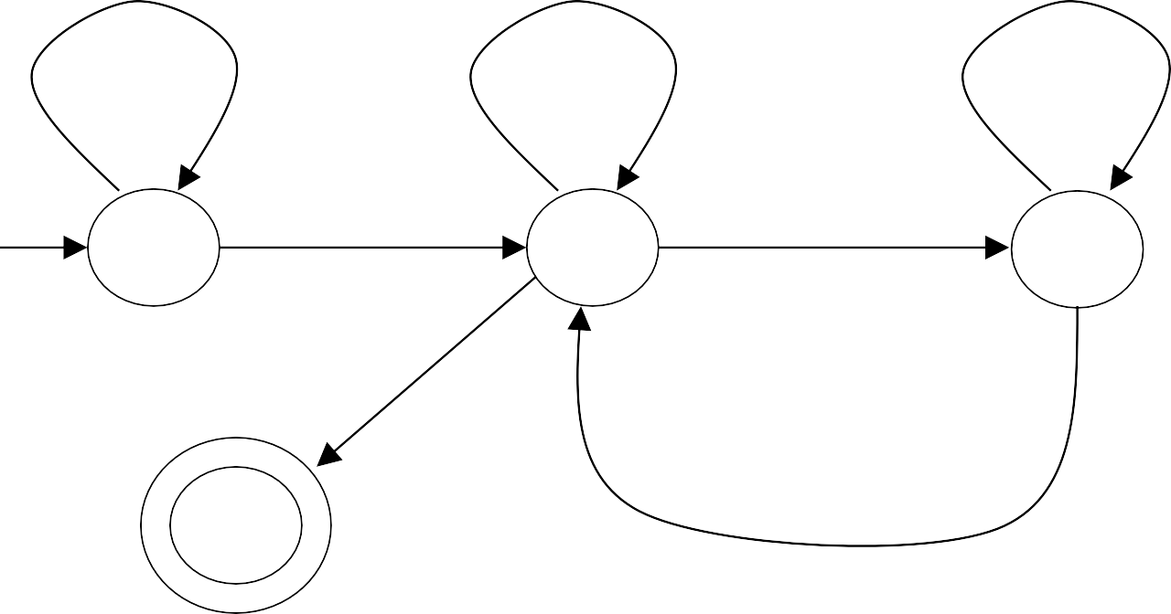
f (x) = 2x
Turing Machine for
1 → $, R
1 →1, L 1 →1, R
_{q0} ◊ → ◊, L _{q1} $ →1, R
q₂
◊ → ◊, R
q₃
→1, L

Slide 154

Example
Start
Finish
◊
1
1
◊
 | ◊ | 1 | 1 | 1 | 1 | ◊
q₀
1 → $, R
q₃
1 →1, R
1 →1, L
_{q0} ◊ → ◊, L _{q1} $ →1, R
q₂
◊ → ◊, R
q₃
→1, L

Slide 155
Another Example
1
if x > y
The function is computable
f (x, y) =
0
if x ≤ y
x0 y
Input:
Output:
1 or 0

Slide 156
Match a 1 from x with a 1 from y
Turing Machine Pseudocode:
Repeat
Until all of x or y is matched
If a 1 from x is not matched erase tape, write 1
else
erase tape, write 0
(x > y)
(x ≤ y)

Slide 157
Combining Turing Machines

Slide 158
Block Diagram
Turing Machine
input
output

Slide 159
Example:
x + y
if
x > y
f (x, y) =
0 if
x ≤ y
x, y
Adder
x + y
x, y
Comparator
x > y
x ≤ y
Eraser
0

Slide 161
Design a TM that computes the function
f (x, y) = x + y
= 0
if x ≥ y if x < y
where x & y are unary. Simulate the working of the TM for x = 2, y = 2.
(12 Marks May-2015(2012 Pattern) EndSem)

Slide 162
Construct a TM to compute
f (a, b) = a − b
= 0
where a > b where a < b
(10 Marks Nov-2017 EndSem)

Slide 163
Turing’s Thesis

Slide 164
Do Turing machines have the same power with a digital computer?

Slide 165
Do Turing machines have the same power with a digital computer?
Intuitive answer: Yes
There is no formal answer

Slide 166
Turing’s thesis:
Any computation carried out by mechanical means
can be performed by Turing Machine
(1930)

Slide 167
Computer Science Law:
A computation is mechanical if and only if
it can be performed by a Turing Machine
There is no known model of computation more powerful than Turing Machines

Slide 168
Definition of Algorithm:
An algorithm for function
f (w)
is a
Turing Machine which computes _{f (w)}

Slide 169
Algorithms are Turing Machines
When we say:
There exists an algorithm
We mean:
There exists a Turing Machine

Slide 170
Algorithm:
An algorithm for a problem is a
Turing Machine which solves the problem
The algorithm describes the steps of the mechanical means
This is easily translated to computation steps of a Turing machine

Slide 171
When we say: There exists an algorithm
We mean:
There exists a Turing Machine that executes the algorithm

Slide 172
Calculations vs. Languages
The “language” for a certain calculation is the set of strings of the form “<input, output>”, where the output corresponds to a valid calculated value for the input
A “calculation” is one that takes an input and outputs a value (or values)
A “language” is a set of strings that meet certain criteria
E.g., The language Ladd for the addition operation
“<0#0,0>”
“<0#1,1>”
… “<2#4,6>”
…
Membership question == verifying a solution e.g., is “<15#12,27>” a member of Ladd ?

Slide 173



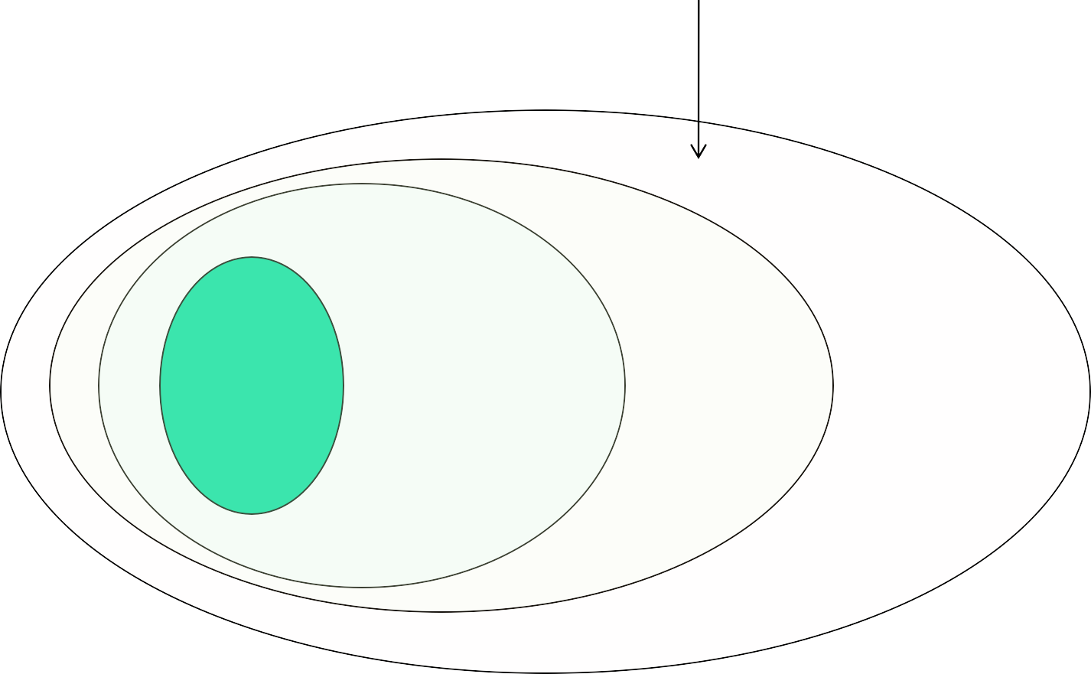
Language of the Turing Machines
Recursive Enumerable (RE) language
Context-
free (PDA)
Regular (DFA)
Context sensitive
Recursively Enumerable

Slide 174
Variations of the
Turing Machine

Slide 175
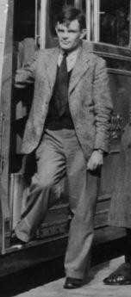
Turing Machines
Proposed by Alan Turing, 1936.
Unlimited and unrestricted memory.
A model of a general purpose computer.
Can do anything that a real computer can do.
Cannot solve all problems!!

Slide 176
The Turing Machine
An infinite tape - unlimited memory.
A tape head - can move left and right.
Can read from the tape and write on the tape.
head
b | b | a | c | b | b | d | a | c | _ | _

Slide 177

The Standard Model
Infinite Tape
◊ | ◊ | a | a | b | a | b | b | c | a | c | a | ◊ | ◊ | ◊
Read-Write Head
(Left or Right)
Control Unit
Deterministic

Slide 178
Variations of the Standard Model
Turing machines with:
Stay-Option
Multiple Track Tape
Semi-Infinite Tape
Multitape
Nondeterministic
Different Turing Machine Classes

Slide 179
Variations of the Standard Model
Turing machines with:
Stay-Option
Multiple Track Tape
Semi-Infinite Tape
Multitape
Nondeterministic
Different Turing Machine Classes

Slide 180
Same Power of two machine classes:
both classes accept the same set of languages
We will prove:
each new class has the same power with Standard Turing Machine
(accept Turing-Recognizable Languages)

Slide 181
for any machine M₁ of first class
Same Power of two classes means:
there is a machine
M ₂ of second class
such that:
L(M₁) = L(M ₂ )
and vice-versa

Slide 182
Turing Machines with Stay-Option
The head can stay in the same position
◊ | ◊ | a | a | b | a | b | b | c | a | c | a | ◊ | ◊ | ◊
Left, Right, Stay
L,R,S: possible head moves

Slide 183
Example:
Time 1
◊ | ◊ | a | a | b | a | b | b | c | a | c | a | ◊ | ◊ | ◊
q₁
Time 2
◊
◊
b
a
b
a
b
b
c
a
c
a
◊
◊
◊
q₂
a → b, S
q₁
q₂

Slide 184
Theorem: Stay-Option machines
have the same power with Standard Turing machines
^{Proof:} 1. Stay-Option Machines
simulate Standard Turing machines
2. Standard Turing machines simulate Stay-Option machines

Slide 185
Multiple Track Tape
A useful trick to perform more complicated simulations
One Tape
track 1
track 2
 | ◊ | ◊ | a | b | a | b | ◊
 | ◊ | ◊ | b | a | c | d | ◊
One head
One symbol (a,b)

Slide 186
track 1
track 2
 | ◊ | ◊ | a | b | a | b | ◊
 | ◊ | ◊ | b | a | c | d | ◊
q₁
track 1
track 2
 | ◊ | ◊ | a | c | a | b | ◊
 | ◊ | ◊ | b | d | c | d | ◊
q₂
(b, a) → (c, d ), L
q₁
q₂

Slide 187
Multi-Track TMs
TM with multiple “tracks” but just one
head
E.g., TM for {wcw | w∈ {0,1}* }
but w/o modifying original input string
BEFORE
control
AFTER
control
Tape head
Tape head
B B 0 1 0 c 0 1 0
… Track 1 …
… Track 2 …
…
…
B B 0 1 0 c 0 1 0 B
B B B B B
B … Track 1
B B B B B
B B X X X c Y Y Y
B … Track 2
Second track mainly used as a scratch space for marking

Slide 188
Semi-Infinite Tape
The head extends infinitely only to the right
.........
Initial position is the leftmost cell
When the head moves left from the border, it returns to the same position
a | b | a | c | ◊ | ◊

Slide 189
Semi-Infinite machines have the same power with Standard Turing machines
Theorem:
^{Proof:} 1. Standard Turing machines simulate Semi-Infinite machines
2. Semi-Infinite Machines
simulate Standard Turing machines

Slide 190
TMs with storage
Generic description
Will work for both a=0 and a=1
E.g., TM for 01* + 10*
Current Storage symbol
Tape symbol
Next state
Current
state
New
Storage
symbol
q
Transition function δ:
storage
δ([q₀,B],a) = ([q₁,a], a, R)
δ([q₁,a],a) = ([q₁,a], a, R)
δ([q₁,a],B) = ([q₂,B], B, R)
Tape head
 | B | B | 0 | 1 | 1 | 1 | 1 | 1 | B | B
…
Are the standard TMs
equivalent to TMs with storage?
Yes
[q,a]:
where q is current state, a is the symbol in storage

Slide 191
Multi-tape Turing Machines
Control unit
(state machine)
Tape 1
Tape 2
 | ◊ | a | b | c | ◊
 | ◊ | e | f | g | ◊
Input string
Input string appears on Tape 1

Slide 192
Tape 1
Time 1
Tape 2
 | ◊ | a | b | c | ◊
 | ◊ | e | f | g | ◊
q₁
Tape 1
q₁
Tape 2
Time 2
 | ◊ | a | g | c | ◊
 | ◊ | e | d | g | ◊
q₂
q₂
_{q1} (b, f ) → (g, d ), L, R
q₂

Slide 193
Theorem: Multi-tape machines
have the same power with Standard Turing machines
^{Proof:} 1. Multi-tape machines
simulate Standard Turing machines
2. Standard Turing machines simulate Multi-tape machines

Slide 194
Nondeterministic Turing Machines
q₂
Choice 1
a → b, L
q₁
a → c, R
q₃
Choice 2
Allows Non Deterministic Choices

Slide 195
Time 0
 | ◊ | a | b | c | ◊
Time 1
Choice 1
q₁
q₂
 | ◊ | b | b | c | ◊
a → b, L
q₂
Choice 2
q₁
a → c, R
q₃
 | ◊ | c | b | c | ◊
q₃

Slide 196
Input string w is accepted if there is a computation:
∗
q₀w  x q _{f} y
Initial configuration Final Configuration
Any accept state
There is a computation:

Slide 197
Theorem: Nondeterministic machines have the same power with Standard Turing machines
^{Proof:} 1. Nondeterministic machines simulate Standard Turing machines
2. Standard Turing machines
simulate Nondeterministic machines

Slide 198
1. Nondeterministic Machines simulate Standard (deterministic) Turing Machines
Trivial: every deterministic machine is also nondeterministic

Slide 199
A Universal Turing Machine

Slide 200
A limitation of Turing Machines:
Turing Machines are “hardwired”
they execute only one program
Real Computers are re-programmable

Slide 201
Solution:
Universal Turing Machine
Attributes:
Reprogrammable machine
Simulates any other Turing Machine

Slide 202
Universal Turing Machine
simulates any Turing Machine M
Input of Universal Turing Machine:
Description of transitions of M
Input string of M

Slide 203
Encoding The Turing Machine to i/p UTM

Slide 204
Tape 1
Three tapes
Description of M
Universal Turing Machine
Tape 2
Tape Contents of M
Tape 3
State of M

Slide 205
Description of M
Tape 1
We describe Turing machine M
as a string of symbols:
We encode M
as a string of symbols

Slide 206
Alphabet Encoding
a
b
c
d
Symbols:
Encoding:
1
11
111
1111

Slide 207
q₁ q₂
State Encoding
States:
q₃
q₄
Encoding:
1
11
111
1111
Head Move Encoding
L R
1 11
Move:
Encoding:

Slide 208
δ (q₁, a) = (q₂ ,b, L)
Transition Encoding
Transition:
Encoding:
1010 11 0 11 01
separator

Slide 209
δ (q₁, a) = (q₂ ,b, L)
Turing Machine Encoding
Transitions:
δ (q₂ ,b) = (q₃,c, R)
Encoding:
1010 11 0 11 01 00 11 0110 111 0 111 0 11
separator

Slide 210
of the simulated machine M
Tape 1 contents of Universal Turing Machine:
binary encoding
Tape 1
1 0 1 0 11 0 11 0 10011 0 1 10 111 0 111 0 1100 …

Slide 211
A Turing Machine is described with a binary string of 0’s and 1’s
Therefore:
The set of Turing machines forms a language:
each string of this language is
the binary encoding of a Turing Machine

Slide 212
Language of Turing Machines
L = { 010100101,
(Turing Machine 1)
00100100101111,
(Turing Machine 2)
111010011110010101,
……
…… }

Slide 213
Universal Turing Machine:
Simulate M on w
UTM(<M, w>) = ^{accept,}
if M accepts w
reject,
if M does not accept w

Slide 214
Comparison of All Automata
FINITE AUTOMATA
A finite automaton (FA) is mathematical model consists of {Q, q₀, ∑,
F, σ} where Q=set of states, q₀=,initial state ∑=input alphabet, F=final
state, σ =transition function.
PUSHDOWN AUTOMATA
A pushdown automaton (PDA) is mathematical model consists of {Q, q₀, ∑, F, ᴦ, σ, z₀} where Q=set of states, q₀=,initial state ∑=input alphabet, F=final state, σ =transition function, ᴦ=stack alphabet,, z₀=stack initial symbol
TURING MACHINE
A Turing Machine (TM) is mathematical model consists of {Q, q₀, ∑, F, ᴦ, σ, B} where Q=set of states, q₀=,initial state ∑=input alphabet, F=final state, σ =transition function, ᴦ=Tape alphabet,, B=Blank symbol

Slide 215
Comparison of All Automata
FINITE AUTOMATA
It doesn’t has the capability to store long sequence of input alphabets.
Input alphabets are accepted by reaching “final states”.
NFA can be converted into equivalent DFA
PUSHDOWN AUTOMATA
It has stack to store the input alphabets.
Input alphabets are accepted by reaching :
Empty stack
Final state
NPDA has more capability than DPDA
TURING MACHINE
It has infinite tape (RAM)to store the input and output alphabets.
Input alphabets are accepted by halting “final states”.
All the TM variations have the same Power.

Slide 216
Comparison of All Automata
FINITE AUTOMATA
– Finite Automata can be constructed for Type-3 grammar
PUSHDOWN AUTOMATA
– Pushdown Automata can be constructed for Type-2 grammar
TURING MACHINE
– Turing Machine can be constructed for Type-0 grammar

Slide 217
Applications of TM
They are a theoretical concept to define the notion of computability.
A modern computer, whether digital or quantum, is, essentially, a realization of a Turing Machine.
Therefore, the Turing machine is just an idea. This abstract machine doesn’t have any real-time applications.

Slide 218
Summary
TMs == Recursively Enumerable languages
TMs can be used as both:
Language recognizers
Calculators/computers
Basic TM is equivalent to all the below:
Multi-track TM
Multi-tape TM
Non-deterministic TM
Enumerator
TMs are like universal computing machines with
unbounded storage (Universal Turing Machine)
Comparison of All Automata

